Slide 1
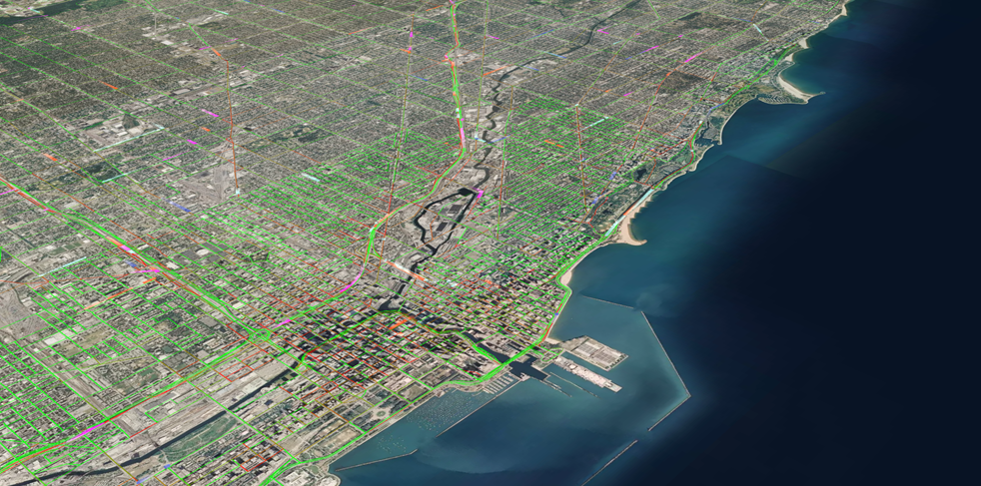
SMART Mobility in a Changing ECOSYSTEM
drhgfdjhngngfmhgmghmghjmghfmf
Ann M. Schlenker
Director, Center for Transportation Research
Argonne National Laboratory
17th Annual JOHN NOEL Public Transit Conference
Smarter Cities, Smarter Counties
Dupage County Division of Transportation
October 13, 2017

Slide 2
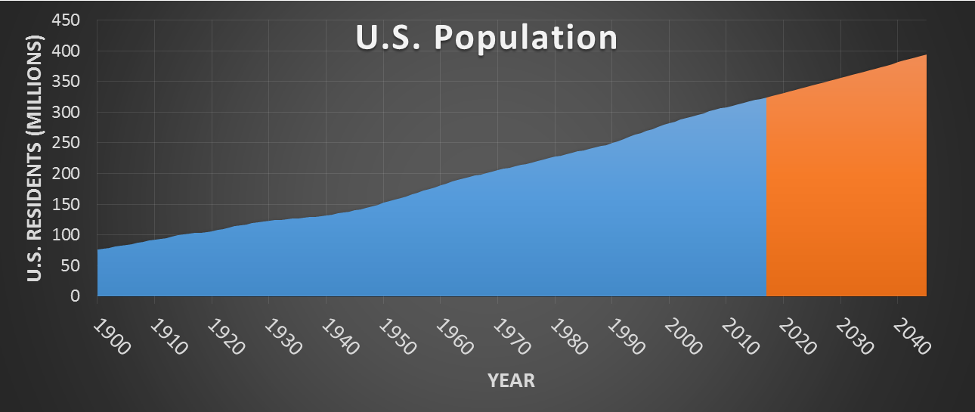



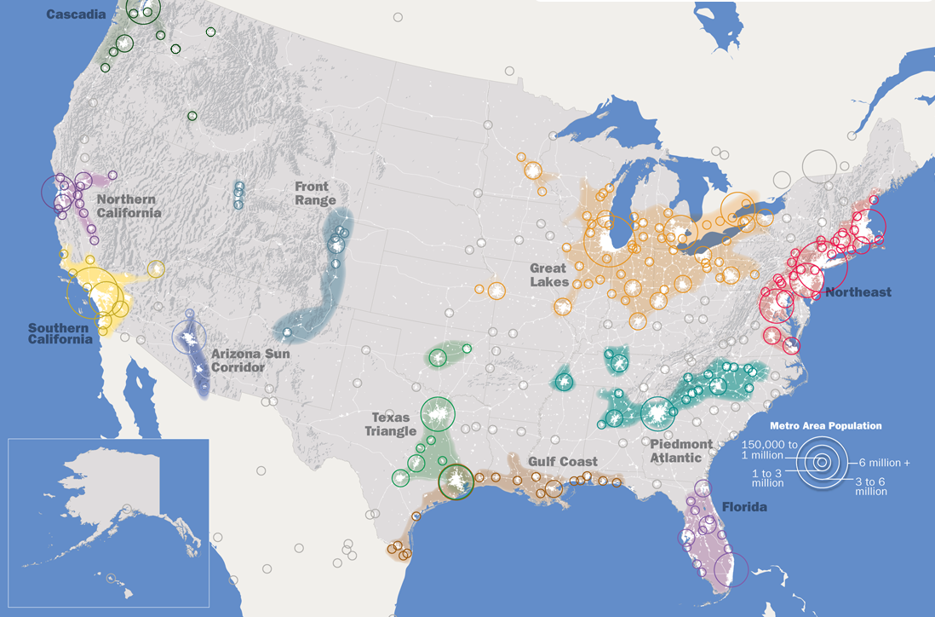





CONVERGING TRENDS ARE SHAPING MOBILITY
Population
Demographics
Technology
Americans are Living Longer
By 2045, the number of Americans over age 65 will increase by 77%.
Integration of Connected & Automated Technologies
ACTUAL
PREDICTED
Introduction of Shared Service Platforms
Population expected to grow by 70 million in next 30 years
About one-third have a disability that limits mobility.
Advancements in Energy Storage Technology
Millennials are Connected & Influential
Deeper Application of Big Data
There are
73 million Americans aged 18 to 34.
Faster Processing Speeds at Decreasing Cost
75% of population concentrated in 11 Megaregions
They drove 20% fewer miles in 2010 than at the start of the decade.
Notes:
11 megaregions are linked by transportation, economics, and other factors.
They represent over 75% of our population and employment.
Population is expected to grow by 70 million people in the next 30 years.

Slide 3
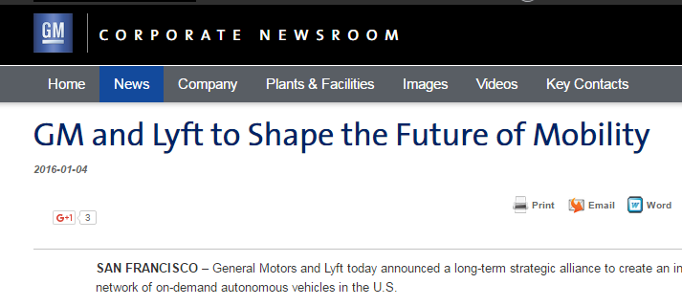
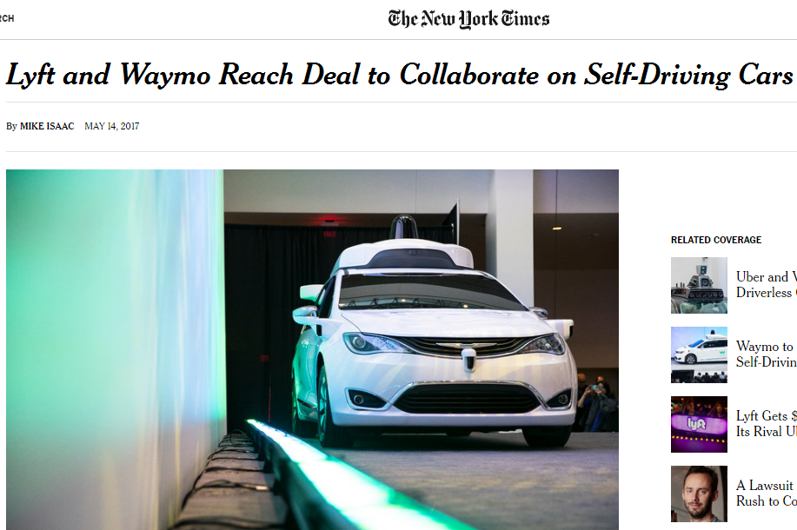
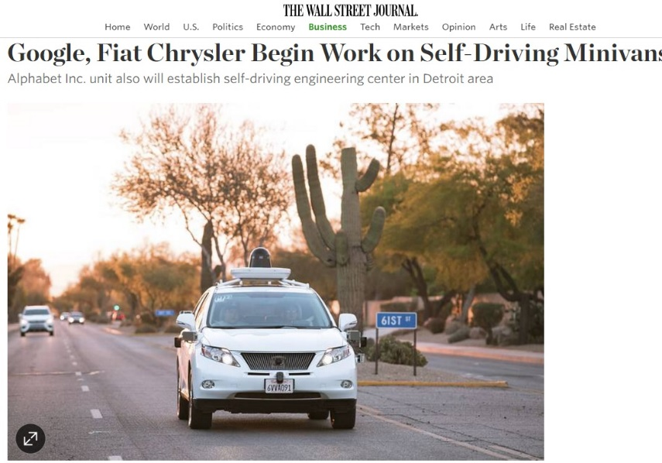
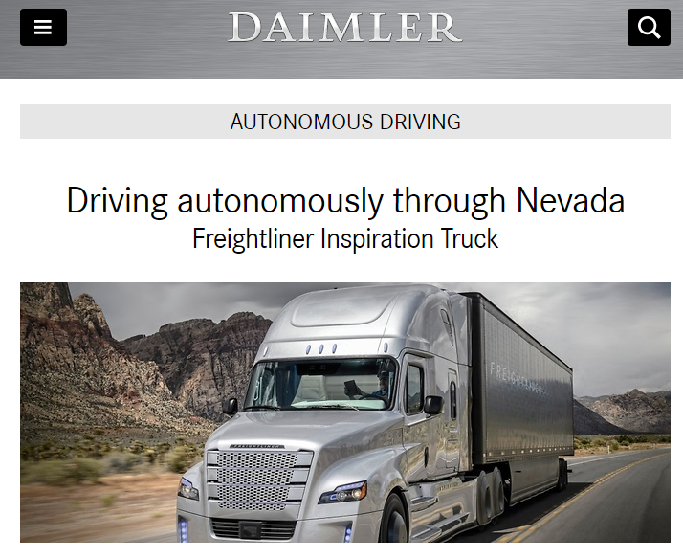

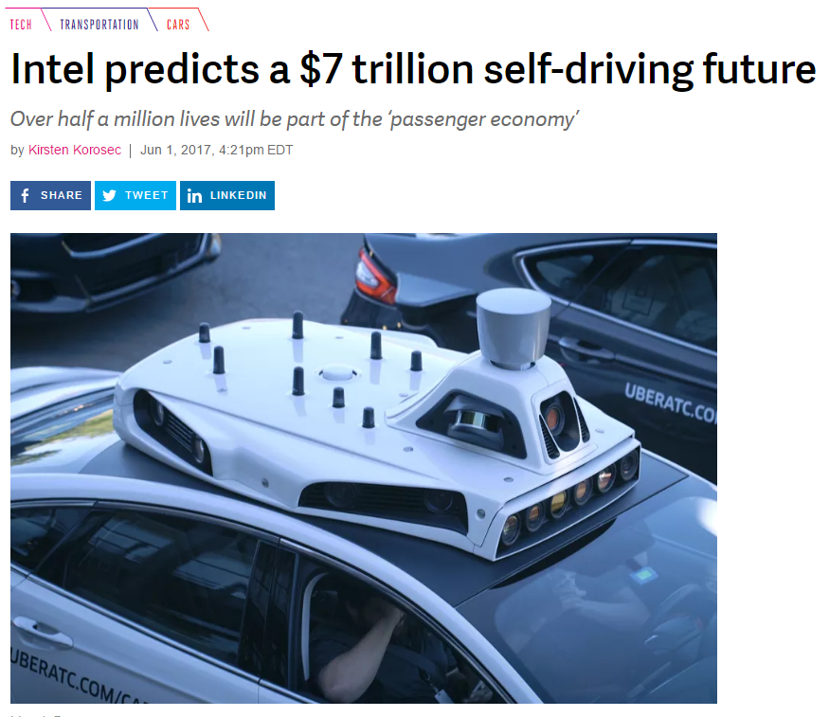
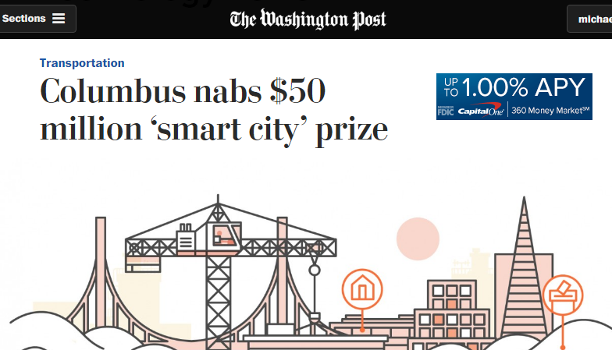
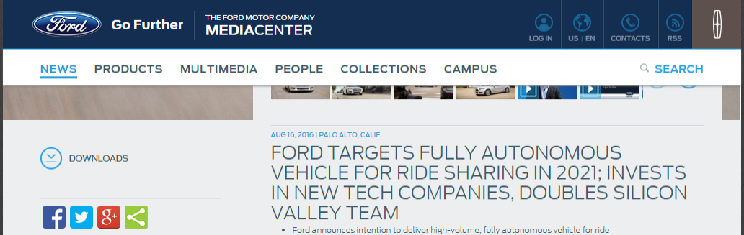
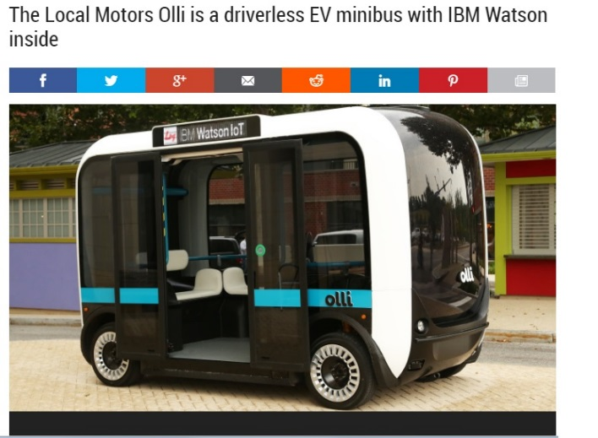
DAILY HEADLINES – SURPRISING PARTNERS and ENTRANTS

Slide 4
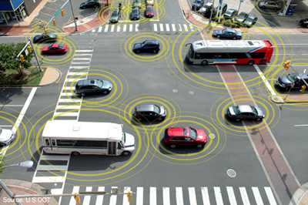
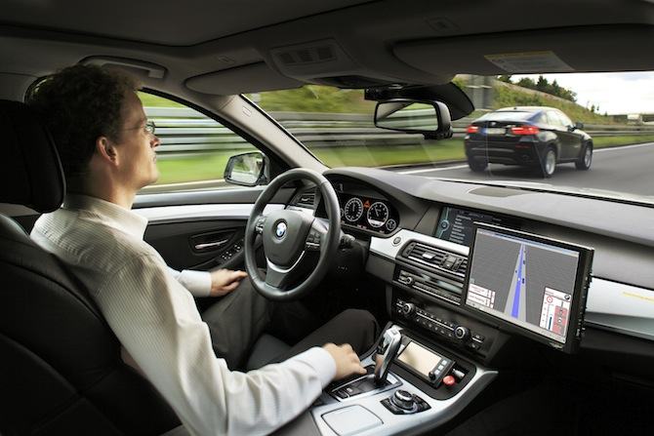
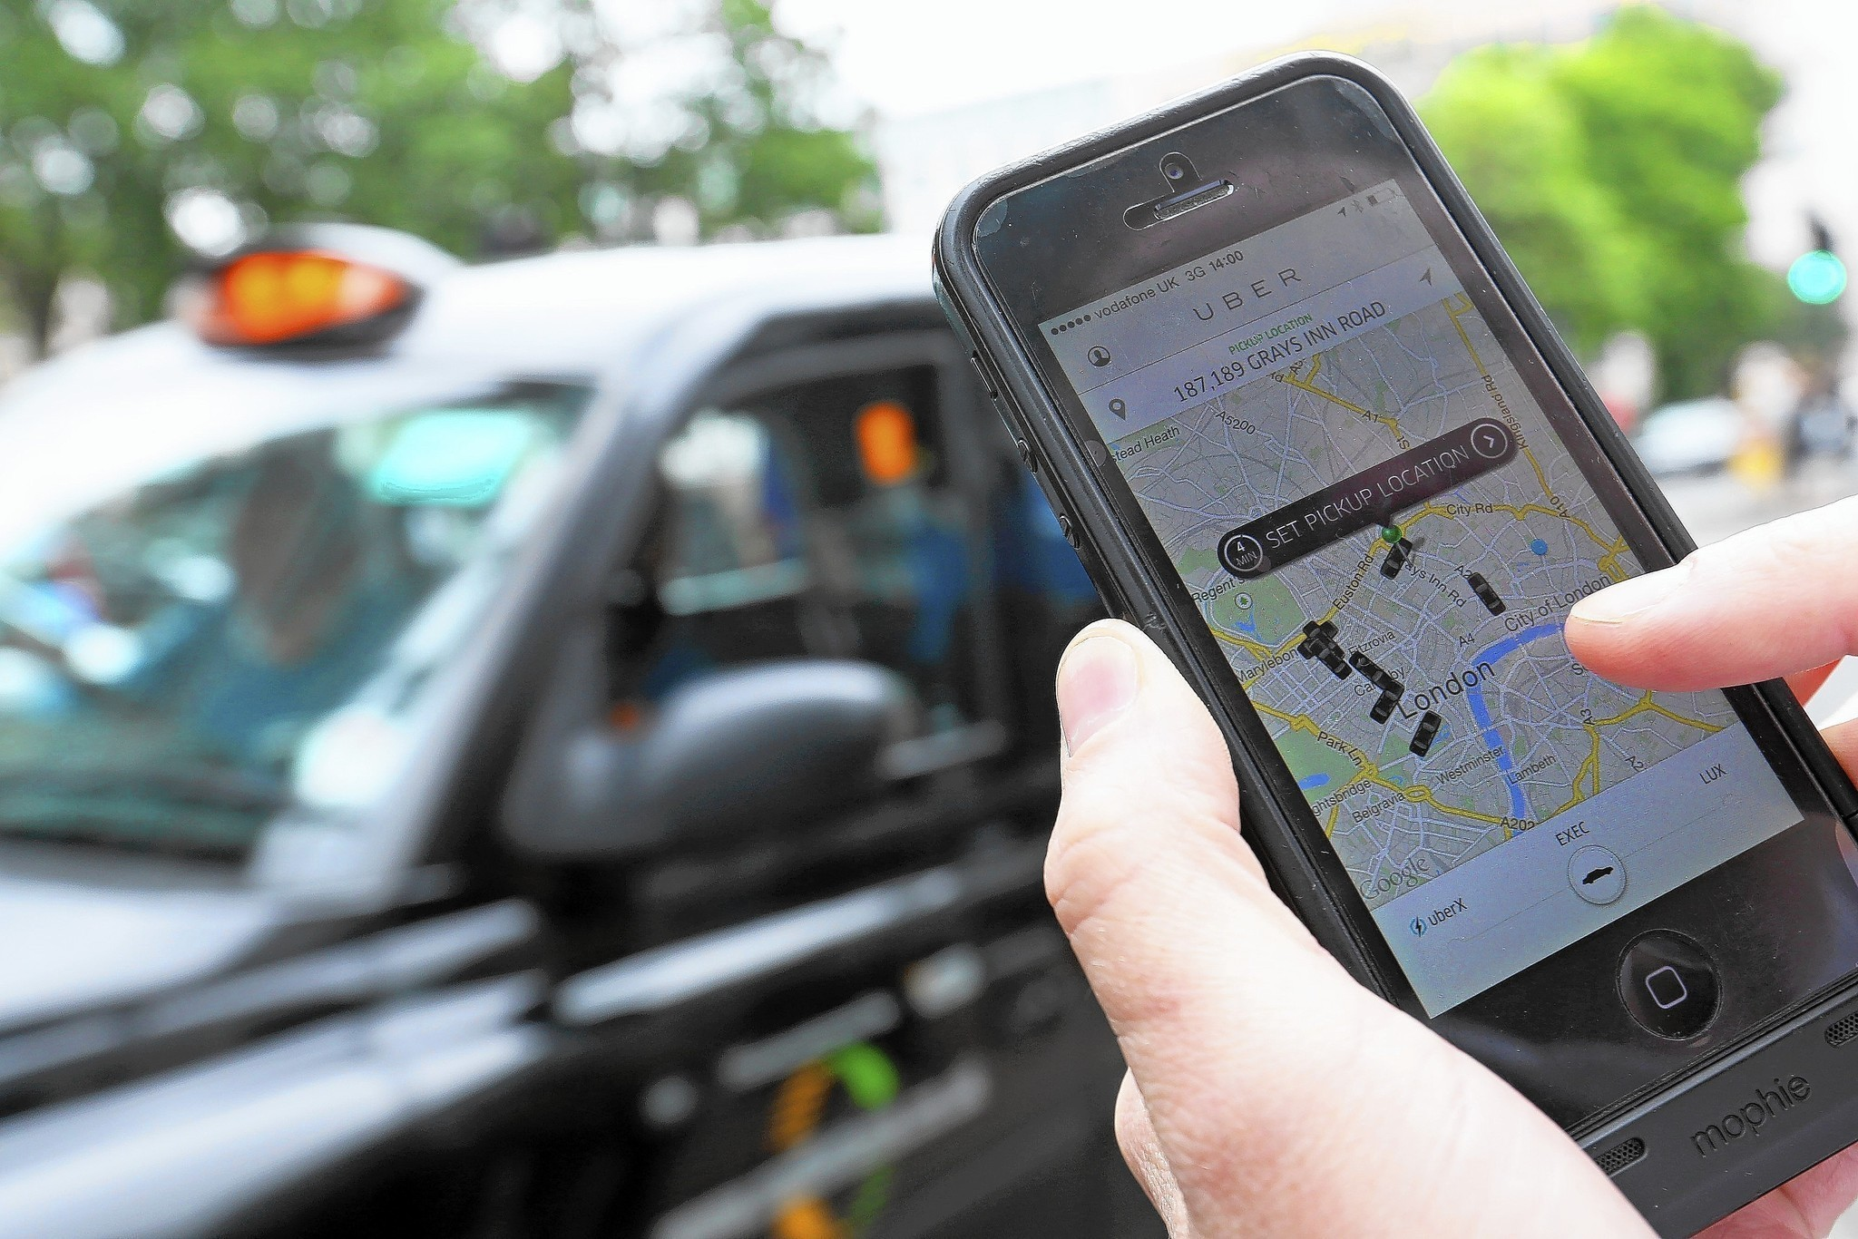
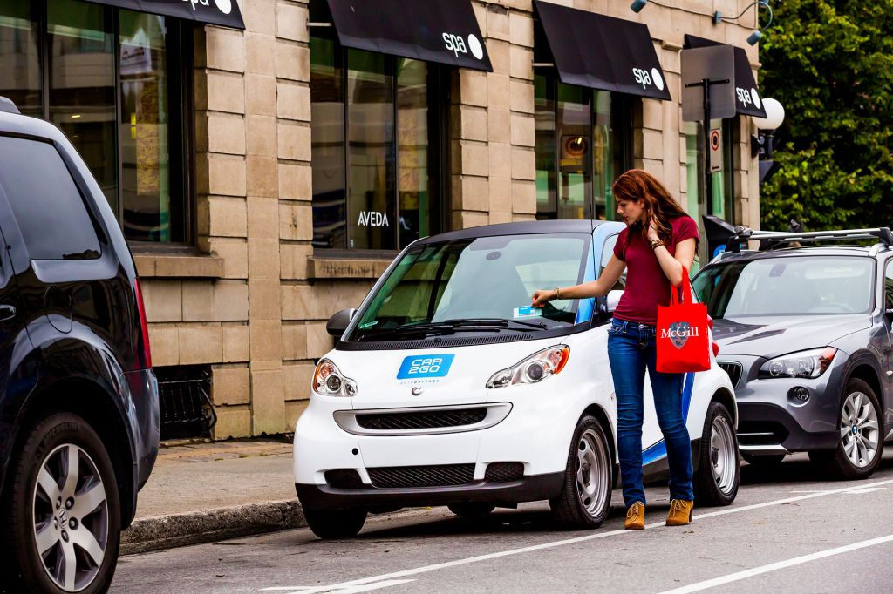
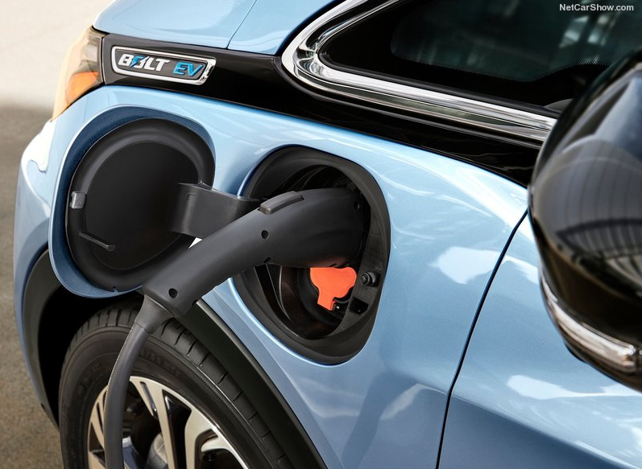
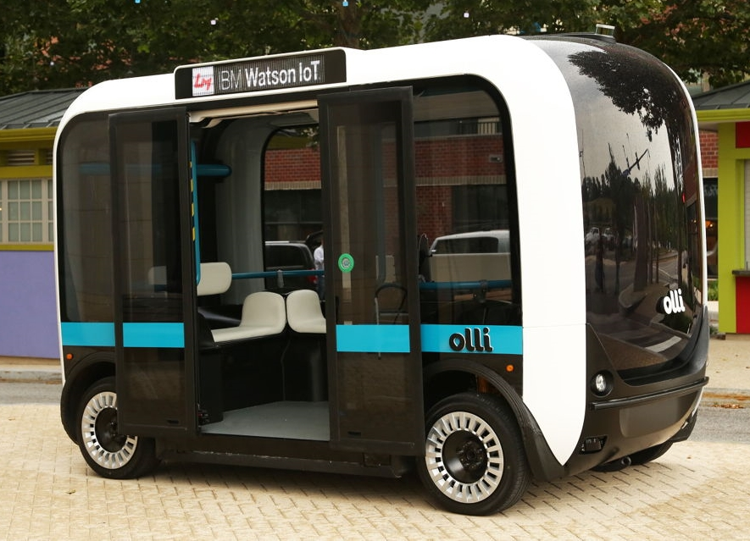
TRENDS ARE CAUSING A FUNDAMENTAL DISRUPTION
Industry is leading the introduction of disruptive business models & technologies based on consumer demand.
How will this disruption lead to new energy efficiency opportunities?
What are the risks to energy use and how can we overcome them?
What are the most promising innovation levers for a sustainable energy future?
Connectivity
Automation
Ride-hailing
Car-sharing
New Powertrains
New Modes

Slide 5

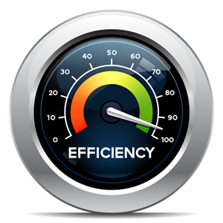



FUNDAMENTAL DISRUPTION IN TRANSPORTATION
How will disruptive forces in the mobility landscape affect energy consumption in the future?
What opportunities exist to enable and/or encourage deep gains in energy efficiency?
What are the most promising system-level innovations that provide the biggest levers?
How can we better understand and leverage how travelers make mobility decisions?
How can we better support and encourage a maximum-mobility, minimum-energy future?

Slide 6
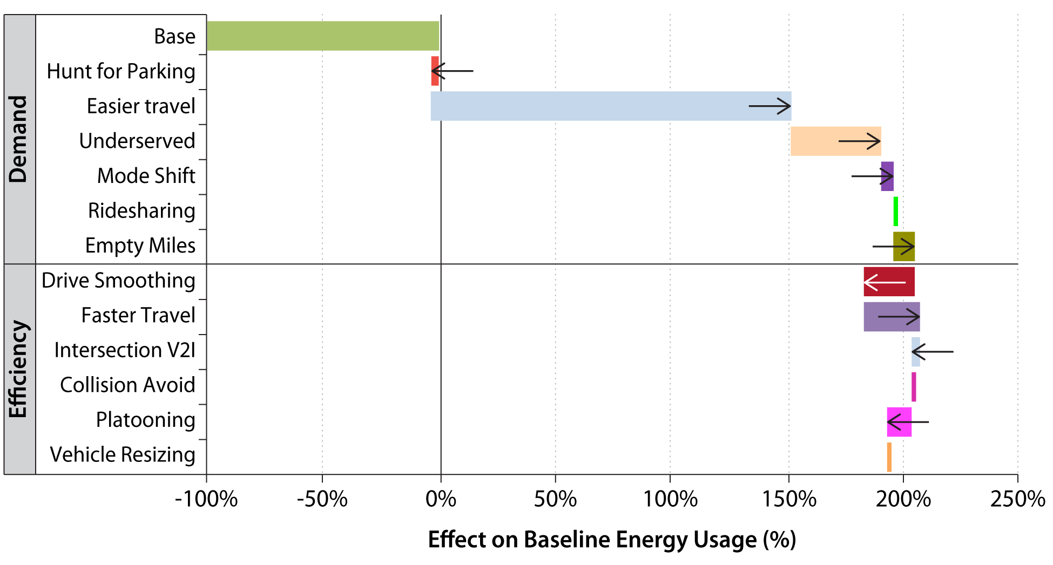
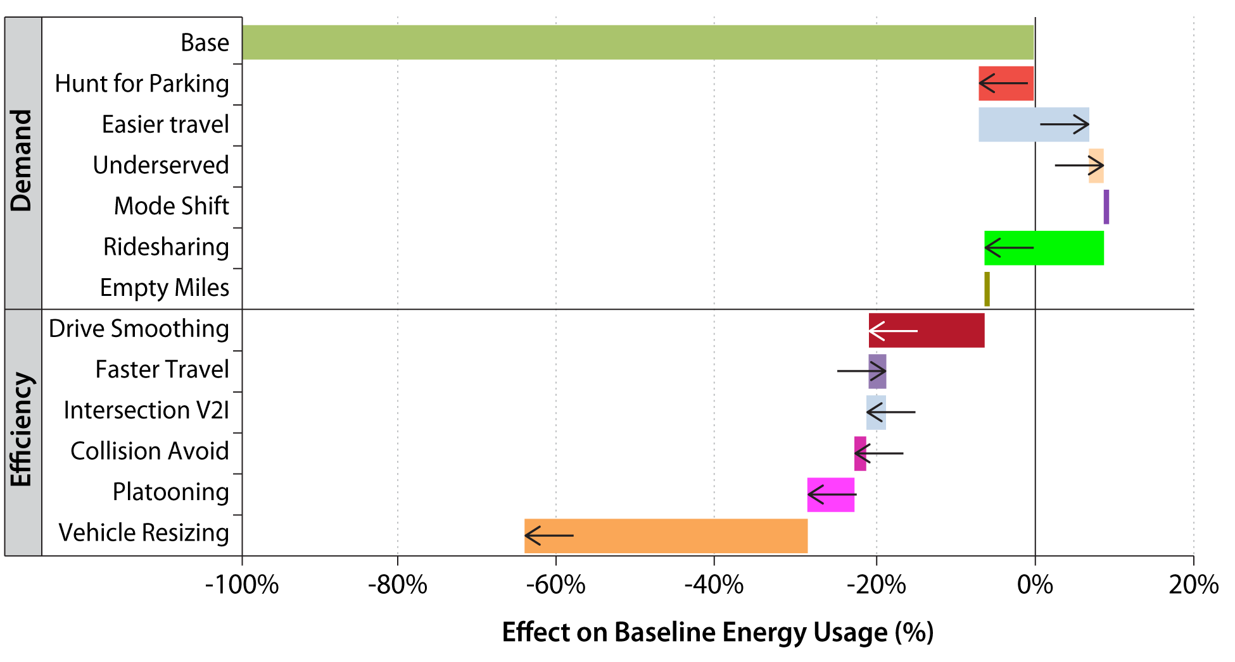
FUNDAMENTAL DISRUPTION, DRAMATIC ENERGY IMPACTS
+200%
Potential Increase in Energy Consumption
Upper Bound Scenario
2050 Baseline Energy Consumption
Potential Decrease in Energy Consumption
Lower Bound Scenario
-60%
  Source: Joint study by NREL, ANL, and ORNL
  http://www.nrel.gov/docs/fy17osti/67216.pdf

Slide 7
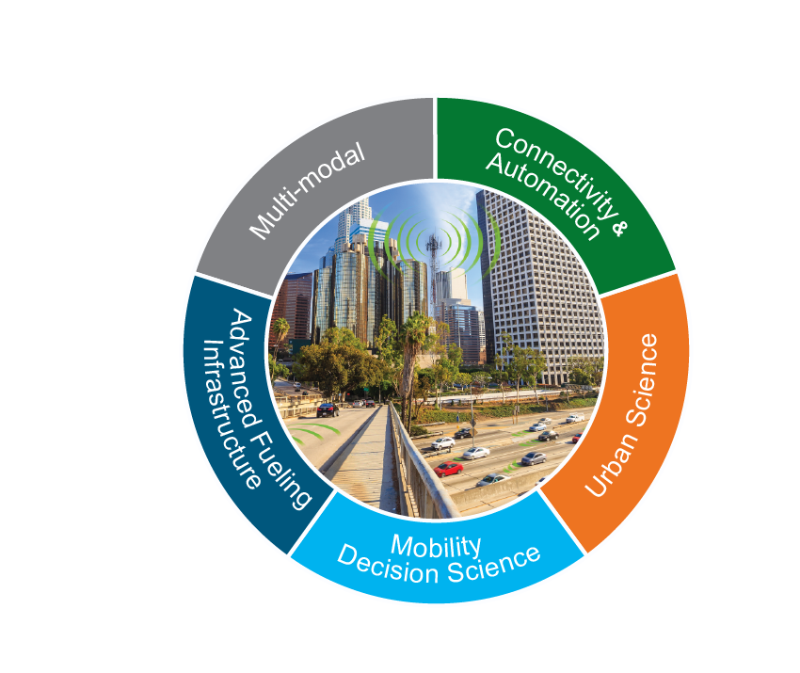
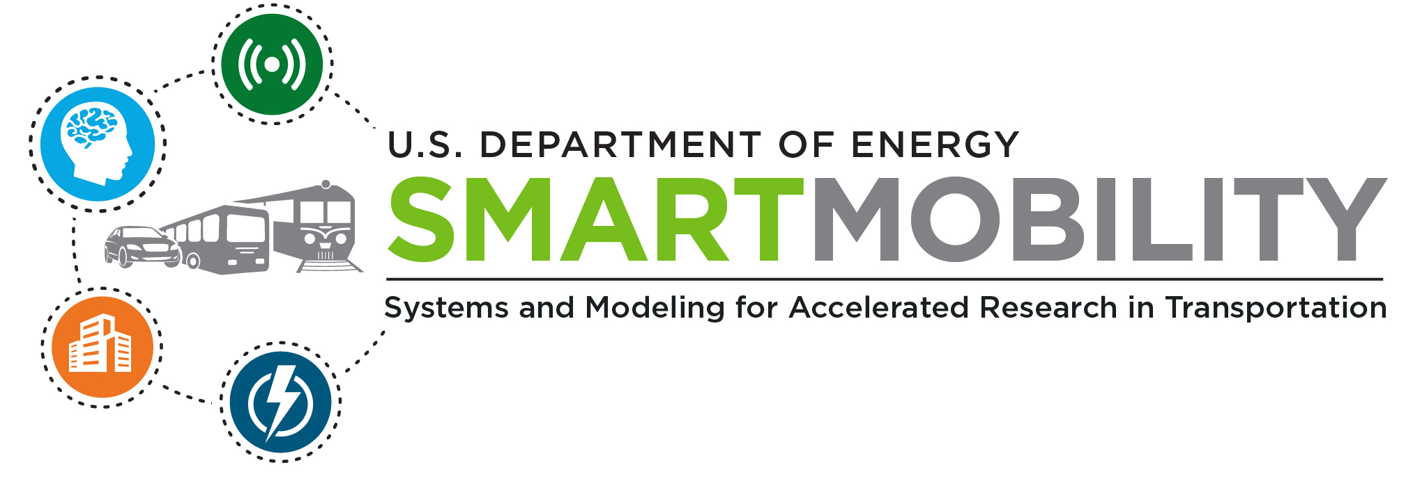
SMART MOBILITY LABORATORY CONSORTIUM
Multi-Year, Multi-Lab Effort (3 years, 5 labs)
Energy implications of connectivity & automation
Multi-modal transport of people and goods
City-scale urban mobility models for planning
Informed fueling infrastructure investments
Understanding consumer mobility decisions

Slide 8

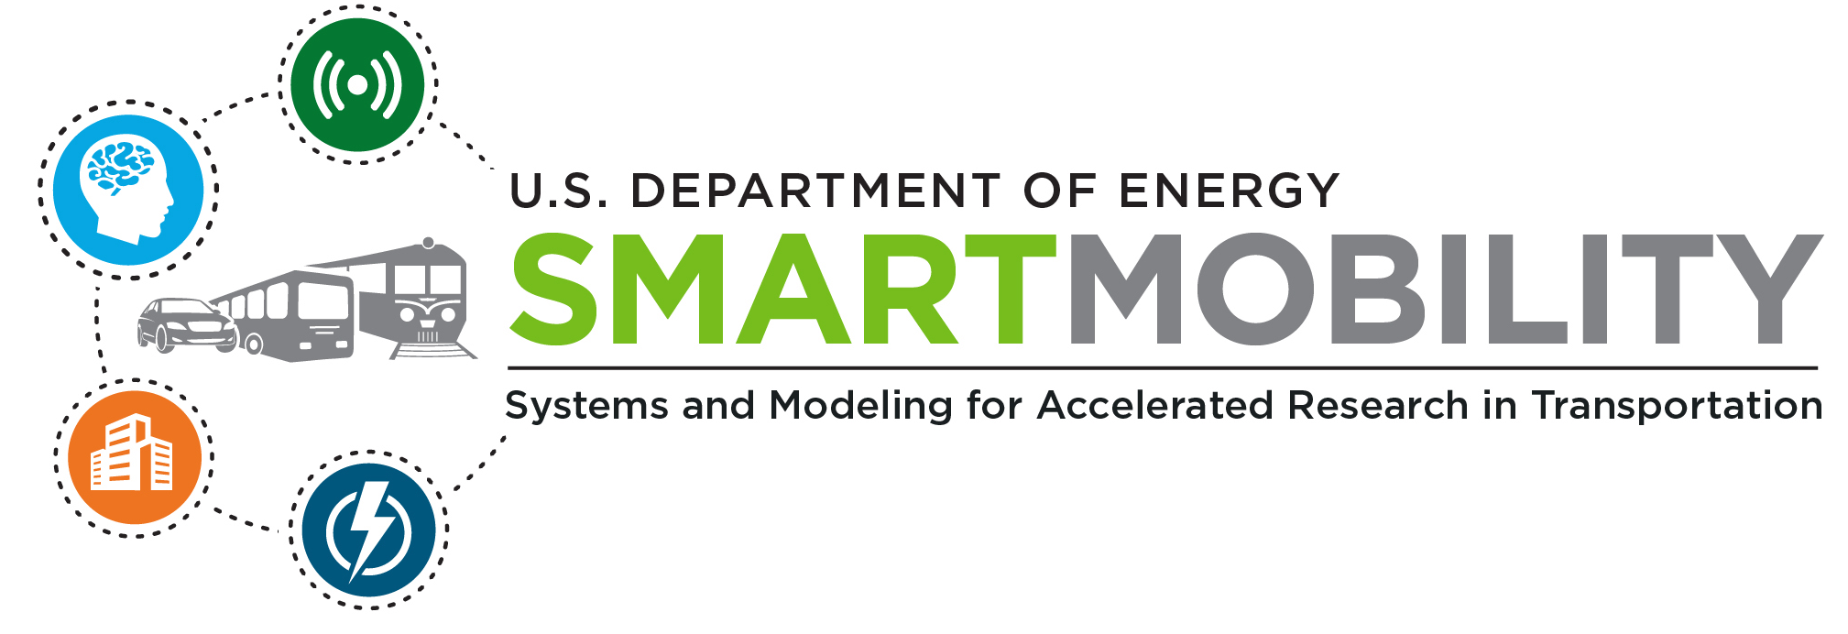
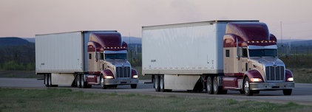
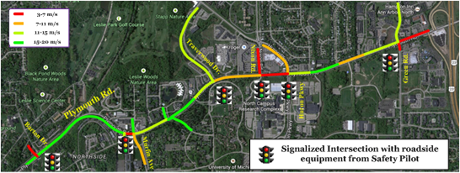
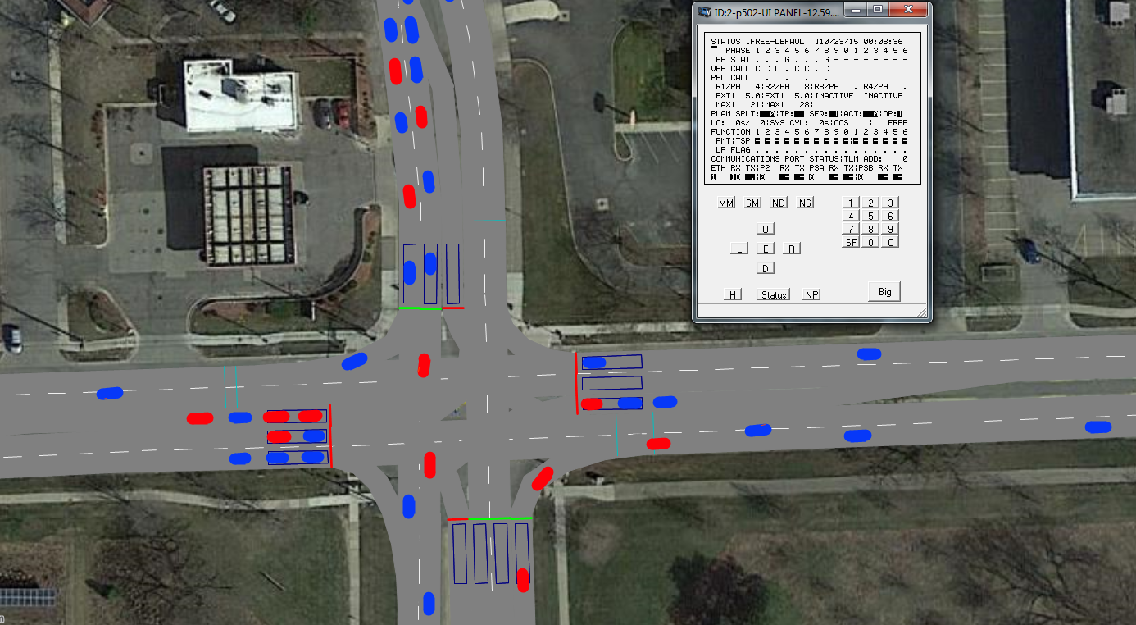
CONNECTED & AUTOMATED VEHICLES (CAVs)
Critical Research Questions:
What are the energy, technology, and usage implications of connected & autonomous technologies?
How will these systems operate in the real world?
What are the critical levers to promote “eco-CAV” solutions?
Designing for the nexus of safety, energy, and mobility

Slide 9


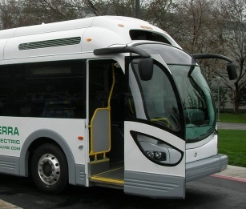

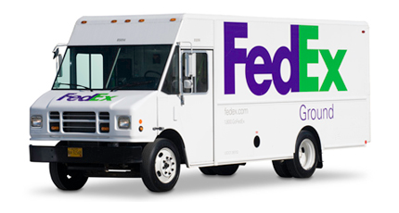

MOBILITY DECISION SCIENCE
Critical Research Questions
What are the transportation energy impacts of potential lifestyle trajectories?
How do consumers and companies make travel decisions in the short / medium / long-term?
What mechanisms are available to influence consumer decisions?
Driving
Transportation System Decision Points
Travel
Technology and policy that anticipate how decisions are made
Lifestyle

Slide 10

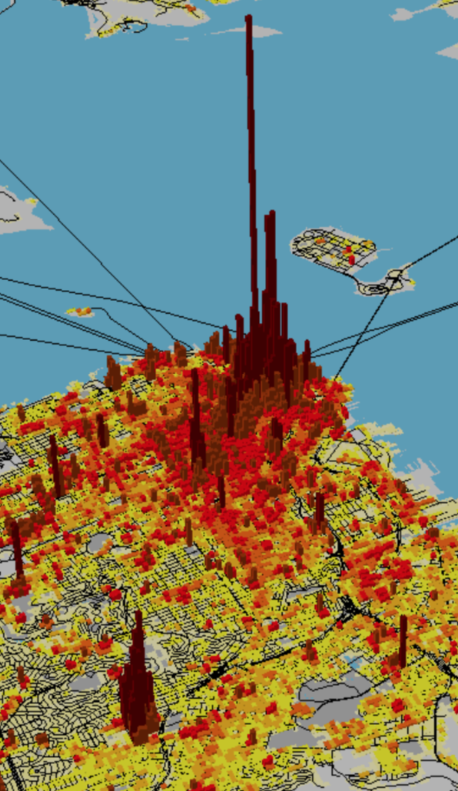
URBAN SCIENCE
Critical Research Questions
How will SMART-enabled mobility impact the urban traveler in terms of VMT, congestion, vehicle ownership, mobility-as-a-service?
What are the long-term impacts on the urban built environment?
What are the energy impacts of optimized signal management and automated mobility districts?
Providing scientific support
to decision makers

Slide 11

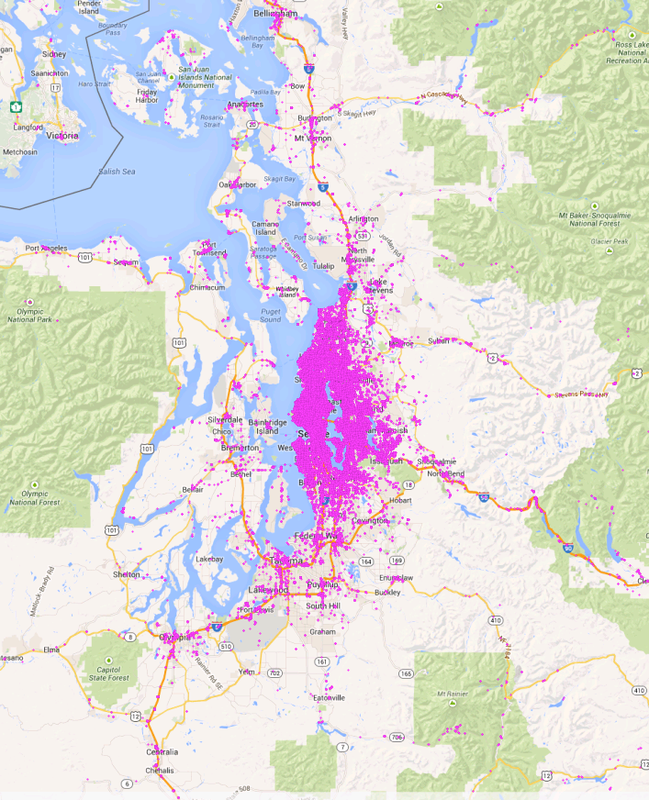
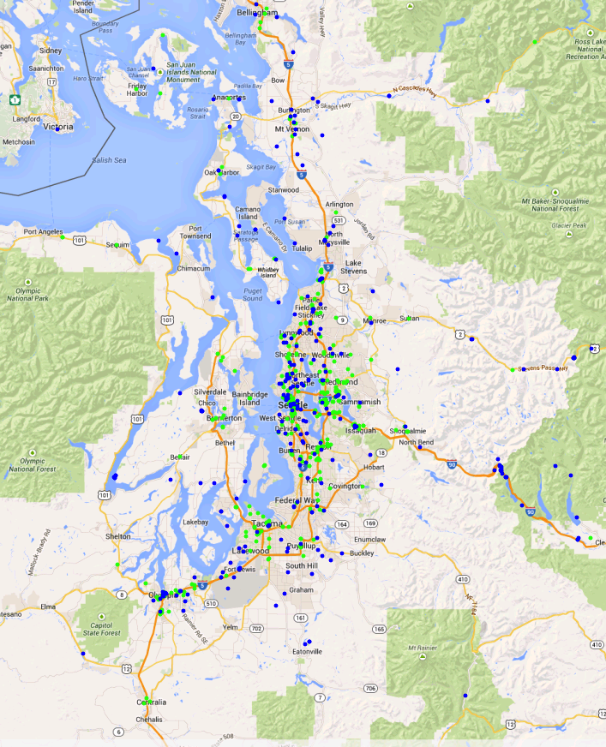
ADVANCED FUELING INFRASTRUCTURE
Critical Research Questions
What infrastructure is required to support future mobility systems?
How can next-gen fueling/charging infrastructure enable low-carbon transportation?
What are the costs and benefits, and where should infrastructure investments be made?
Mapping EV Technology
with Travel Patterns Reduced EVSE Locations from 18,000+ to 281 in Seattle
Informed infrastructure investments that drive consumer adoption

Slide 12
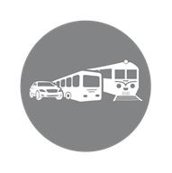
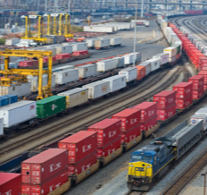
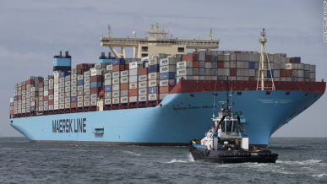
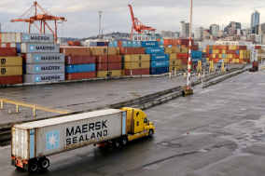

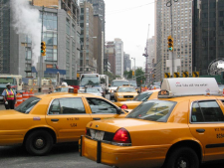
MULTI-MODAL TRANSPORTATION
Critical Research Questions
What are the potential energy benefits of reduced modality interface barriers?
What are the interactions between mass transit and transportation network companies?
What opportunities do evolving household spending and commodity flow bring for freight logistics?
Smart Mobility
Energy-efficient, seamless multi-modal transport of people and goods

Slide 13
Examples of a Few High Level Accomplishments

Slide 14
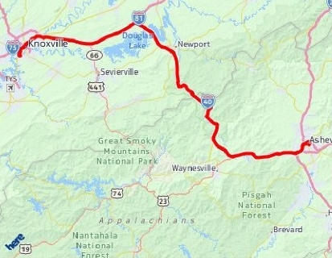
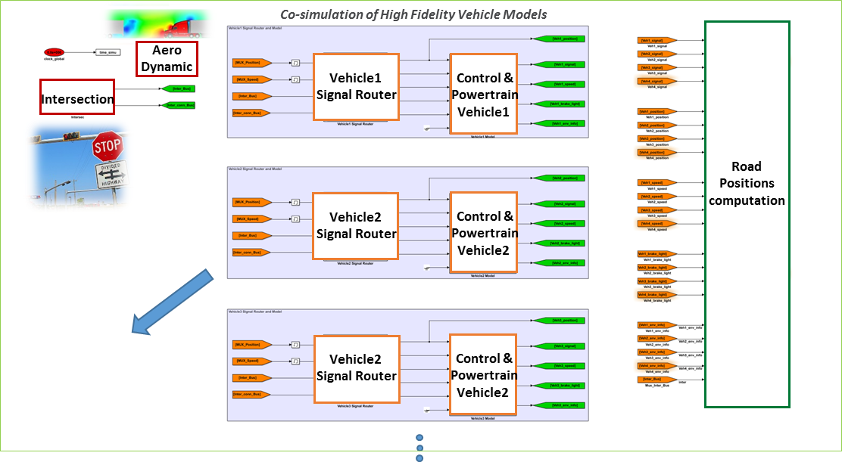
ACCOMPLISHMENT: Advanced Control of CAVs (EEMS016)
Automation
Connectivity
Cloud, Digital Maps,
V2V, V2I
Future road information
speed limits, grade, traffic lights, preceding vehicles, traffic, etc.
Intelligent
Energy-Efficient
CAV
Electrification
+ other advanced powertrain tech
Sensing + Vision
1. Advanced Control
2. CAV + Environment Modeling Framework
Optimized speed and powertrain operations, using optimal control theory and model-predictive control (MPC)
Simulated a broad range of driving situations, powertrains and CAV technologies
w/ MPC 4% fuel savings
2h+ highway trip
conventional LDV
with cruise control

Slide 15
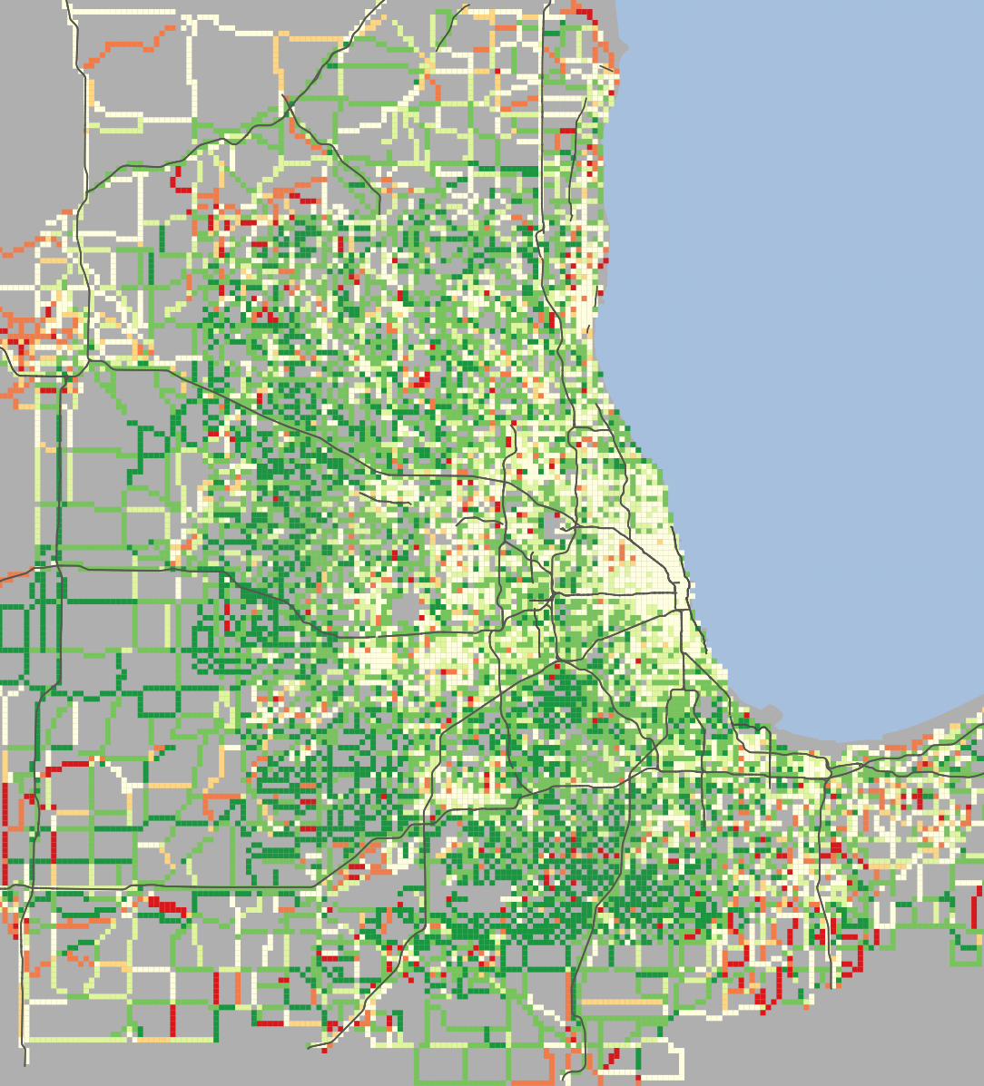


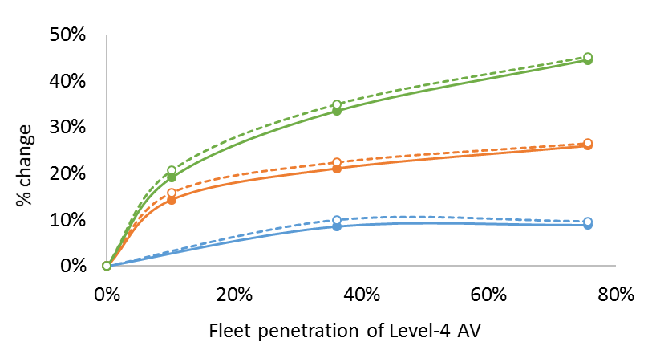
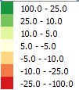
ACCOMPLISHMENT: Regional CAVs Energy Use (EEMS017)
Evaluated CAV adoption and effect on travel demand and traffic flow
Benefits due to improved traffic flow offset by increased VMT due to induced demand
VMT increases with CAVs market penetration and reduced value of travel time (VOTT)
Fuel consumption increased over 43% in worst case scenario
Comparison of low and high penetration fuel use at 70% of current value of travel time
VMT
Energy
VOTT=100%
VOTT=70%
VOTT=50%
%Δ fuel use
Dark green areas indicate higher fuel consumption in high penetration scenario

Slide 16

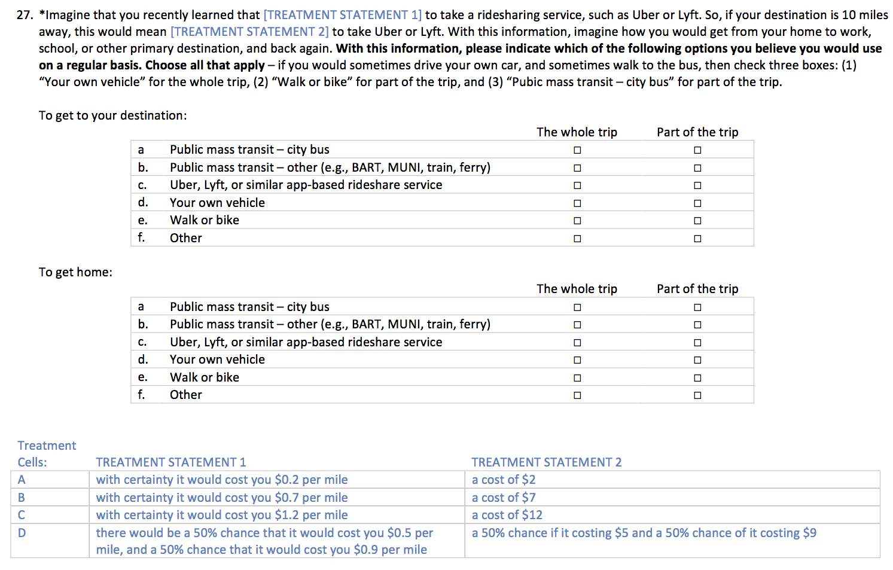
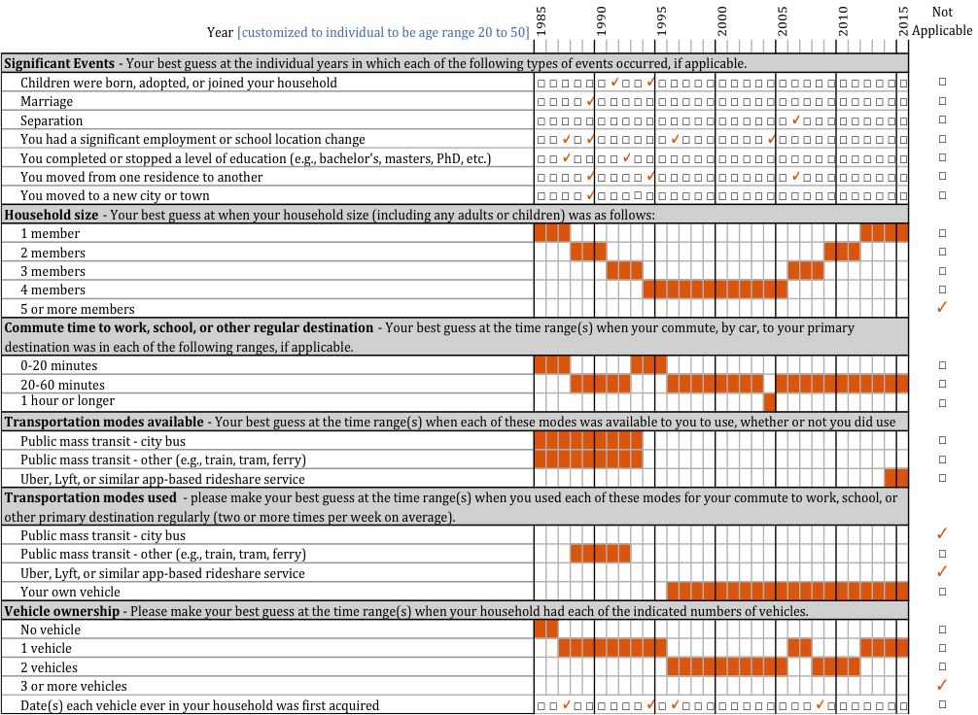
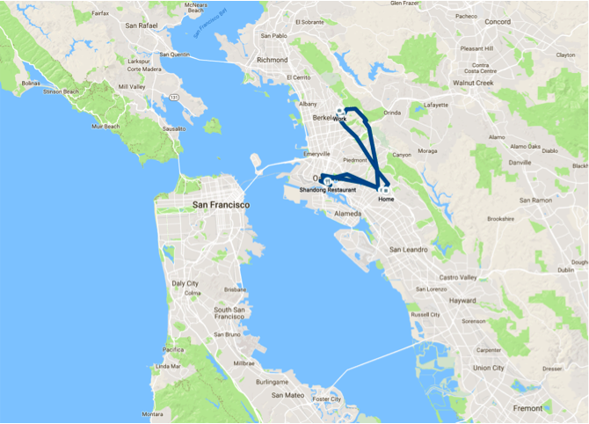
ACCOMPLISHMENT: WholeTraveler Behavior Study (EEMS023)
Designed two-phase survey with innovative features
  Life History Calendar
  Inexpensive and efficient GPS data collection
  Ability to compare stated and revealed preferences
  Creative experimental questions to understand preferences and transportation megatrends
Short Medium Long Future

Slide 17
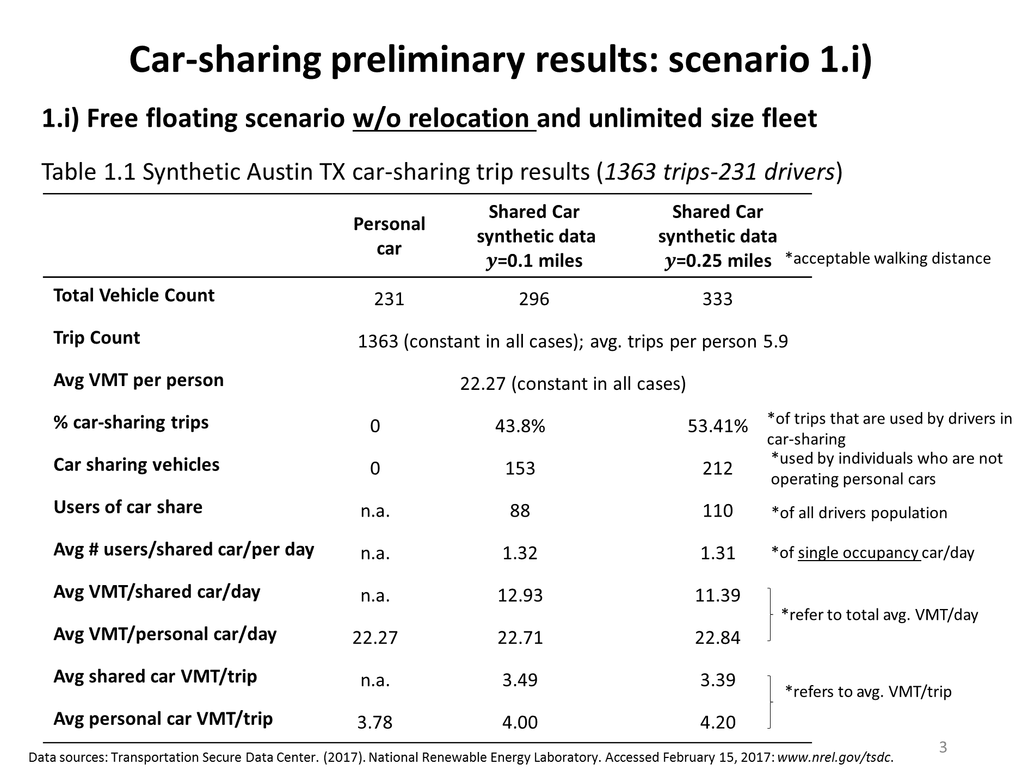
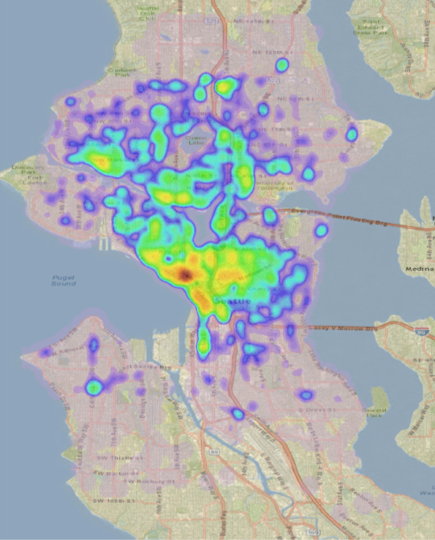
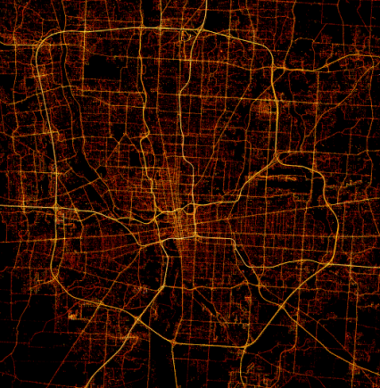


ACCOMPLISHMENT: Emulated Car-Sharing Demand (EEMS012)
Method for emulating shared mobility vehicle data
Modeling advanced fueling infrastructure requires spatially-resolved vehicle activity patterns
Despite the proliferation of shared mobility companies, access to shared mobility data is limited
AFI team developed algorithms to synthesize car-sharing vehicle trajectories from personal vehicle GPS trajectories
Real-world car-sharing data obtained from ReachNow – will be used to validate emulated data
Real-world travel profiles
Rescheduling algorithms to emulate car sharing, ride sharing, or ride hailing
ReachNow free-floating car-sharing vehicle parking density in Seattle, WA
May 2016 to Feb 2017
Preliminary Results

Slide 18
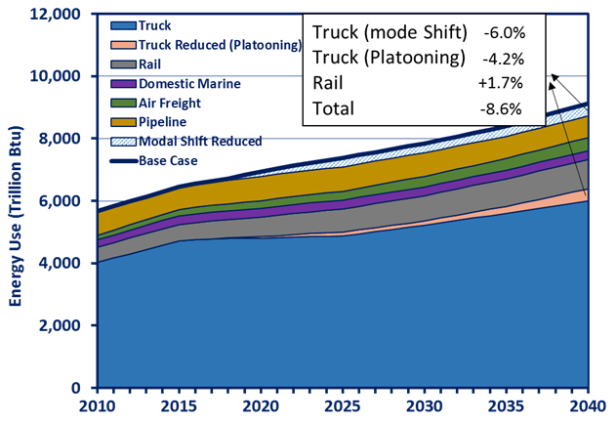
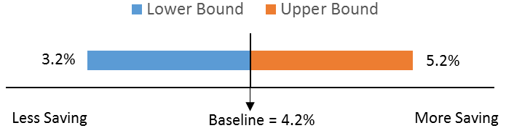
ACCOMPLISHMENT: Quantified Platooning Potential (EEMS025)
Completed initial assessment of national energy and emission impacts:
Platooning may significantly cut inter-city freight energy use
Conclusions:
Cumulative freight sector total energy saving (2016-2040) due to truck platooning could be up to 5.3 Quad BTU (upstream included)
Annual freight energy consumption could be reduced by ~ 5% due to truck platooning in 2040
Earlier analysis indicates mode shift from truck to rail could reduce annual truck energy consumption by additional 6% in 2040
Method and Assumptions
Use Argonne’s NEAT model which captures freight energy saving by commodity type, mode and length of haul.
Platoonable ton-miles increase from 0% to 65% over the time horizon of 2016 ~ 2040
Energy intensity (BTU/ton-miles) decrease 4% for leading trucks and 10% for following trucks. (On average, one leading truck is followed by 3 following trucks.)
Sensitivity analysis: the platoonable ton-miles varies from 50% ~ 80% at 2040
Sensitivity analysis for energy saving due to platooning at 2040

Slide 19
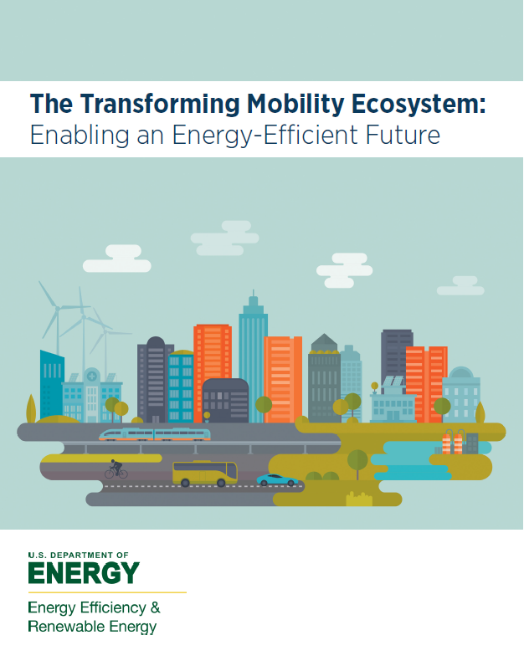

STAKEHOLDER ENGAGEMENT: TRANSFORMING MOBILITY ECOSYSTEM
How do we move forward to achieve aspirational outcomes for the economy, safety, affordability, accessibility, and energy-efficient mobility?
https://energy.gov/eere/vehicles/downloads/transforming-mobility-ecosystem-report
Notes:
Personal-Autonomy
ASPIRATIONAL Factors
[Market]: VMT increase curbed by inherent upper bounds on the value of time spent commuting or in a vehicle; suburbanization is stymied as urban design and land-use patterns
[Policy]: Policies and incentives for zero-emissions vehicles (ZEVs) are consistent, understandable and transparent; Well-coordinated rule tightly regulate zero-occupancy vehicle use
[Technology[: Powertrain efficiencies gained from predicative capabilities, platooning, and eco-driving; Light weighting boosts efficiency and drives down operating costs; Extended range and faster fill rate for alternative fuels allow ZEVs to predominate the market
CAUTIONARY Factors:
[Market]: VMT growth explodes; urban density decreases
[Policy]: Policies/Incentives for ZEVs don’t materialize; Zero-occupancy vehicles go unregulated
[Technology]: Powertrain efficiencies limited by demand for better performance; light weighting limited by safety concerns; ICEs remain predominate
Shared-Mobility
ASPIRATIONAL Factors
[Market]: VMT mitigated by higher occupancy trips and efficient routing; congestion mitigated by increased traveler throughput; increased competition increases vehicle/system efficiencies
[Policy]: expanded curb-side access for shared mobility; higher occupancy trips and efficient modal shifting
[Technology[: manufacturability for swappable parts; trip specific vehicle choice
CAUTIONARY Factors:
[Market]: high VMT due to new user groups; higher congestion; market dominance of handful of service providers
[Policy]: private parking; single occupancy and inefficient modal shifting
[Technology]: safety concerns limit manufacturing design; trip-specific vehicle choice too expensive
Shared-Automated
ASPIRATIONAL Factors
[Market]: VMT limited by inherent upper bounds on time spent commuting or in a vehicle, and partnerships with other transportation modes (e.g., walking, biking, and mass transit); urban redesign
[Policy]: data is shared; consistent safety and service
[Technology[: V2X is ubiquitous; powertrains designed for efficiency; ZEVs
CAUTIONARY Factors:
[Market]: VMT increased due to negation of first-mile, last-mile; vehicle only urban design
[Policy]: data not shared; no common standards
[Technology]: V2X not ubiquitous; performance > efficiency; ICEs

Slide 20














UMBRELLA - ENERGY EFFICIENT MOBILITY SYSTEMS (EEMS)
Energy Efficient Mobility Systems
5-Lab Consortium
EEMS will identify and support technologies and innovations that encourage a
Maximum-Mobility, Minimum-Energy Future
R&D
Technologist In Cities
Virtual Ultra-High Efficiency City
Living Labs
TRANSNET
NEXTCAR

Slide 21



MEMORANDUM OF UNDERSTANDING WITH DOT
MOU signed between DOT/OSTR-R and DOE/EERE to:
Pursue key collaborative opportunities to accelerate innovative “smart” transportation systems research, development, demonstration, and deployment
Recognize mutual interest in the economic, environmental, and national security benefits of smart transportation technologies
GOALS
Gain mutual benefit from coordination between DOT’s Smart City Challenge and VTO’s SMART Mobility Lab Consortium.
Provide leadership and best practices in the development and analysis of transportation data management.
Leverage each agency’s technical expertise and previous experience in mobility related technologies.
Utilize and share existing stakeholder networks for institutional knowledge of local resources.
Support a Technologist-in-Cities pilot, embedding a mobility energy expert within a Smart City.

Slide 22
DOT AND LESSONS LEARNED: SMART CITY APPLICANTS

Slide 23
DOT MOBILITY ON DEMAND SANDBOX – User Centric Philosophy
OSU Image

Slide 24



LIVING LABS: Columbus, Austin, Denver, Detroit, Chicago, San Francisco, Atlanta …
Work with cities and stakeholders for field evaluations and to collect data as new mobility systems are deployed.
Provides important feedback mechanism to R&D
Real-world data to test, validate and improve models, simulations, software and hardware
Understand key energy metrics
Detroit Future City Scenarios
population, employment, land use, mobility changes

Slide 25
CONCLUSION
Major disruption occurring in transportation
Connected & Autonomous Vehicles (CAVs) are coming
CAVs & Shared Mobility have dramatic implications for energy use
  We must understand energy impacts and develop the knowledge to enable energy efficiency in transportation
A Maximum-Mobility, Minimum-Energy Future

Slide 26
Supplemental

Slide 27








Beyond Congestion Impacts
Each Year, Traffic Congestion Costs Us:
Time
Fuel
Money
6.9 Billion Hours
3.1 Billion Gallons
$160 Billion
Data from Schrank, B., Eisele, B., Lomax, T., and Bak, J. (2015). 2015 Urban Mobility Scorecard. Technical report, Texas A& M Transportation Institute..

Slide 28

The future of Mobility…
Source: ‘Energy Efficient Mobility Systems’. DOE/Michael Berube. 2016

Slide 29












SMART MOBILITY LAB CONSORTIUM
Multi-Lab Consortium creating new knowledge and understanding about the energy implications and opportunities from future mobility.
Connected & Automated Vehicles
Mobility Decision Science
Multi-modal Transport
Advanced Fueling Infrastructure
Urban Science
Quantifying energy savings potential of vehicle connectivity and automation in merging roadway scenario (ORNL).
Quantifying the energy benefits of CAV-
enabled drive smoothing for multiple
powertrain technologies (ANL).
Modeling charging requirements for electrified shared mobility service fleets using spatially-resolved vehicle activity patterns (INL/NREL).
Analyzing energy impacts of autonomous
driving in Chicago metropolitan area
using agent-based transportation
simulation (ANL).
ReachNow free-floating car-sharing vehicle parking density in Seattle, WA
May 2016 to Feb 2017
Comparison of low and high penetration fuel use at 70% of current value of travel time
Comparison of low and high penetration fuel use at 70% of current value of travel time
%Δ fuel use
%Δ fuel use
Notes:
Left Side: What it is. Right Side: Examples.
Creating physics based model and simulation, using HPC, studying new algorithms of vehicle control

Slide 30





HPC / BIG DATA ANALYTICS
Develop and apply national lab expertise in high-performance computing, machine-learning, and big data science to find solutions to real-world transportation energy challenges.
HPC4Mobility: Small seedling projects to partner national lab high-performance computing expertise and resources with 3rd parties who have access to data.
  EXAMPLE: Machine learning to find ways to improve energy efficiency of a transportation network
Big Transportation Data Analytics: National-lab based data-science projects to apply Big Data techniques to emerging large/complex transportation data sets.
  EXAMPLE: Use artificial intelligence to develop spatio-temporal mobility applications that reduce energy

Slide 31





ADVANCED R&D PROJECTS
Partner with industry and academia to research and develop mobility technology solutions that lead to energy efficiency savings.
Solutions may include:
Hardware devices
Software solutions
Control systems
Advanced sensors
Powertrain components
Develop an adaptive spatio-temporal intersection control system that reduces fuel use by ~15% while improving travel time (University of Michigan).
Create anticipative/collaborative vehicle control software using connectivity & automation, and demonstrate energy savings through closed-track vehicle-in-the-loop testing (Clemson University).

Slide 32
Goldilocks Problem – And Social Sciences

